Slide 1
by Karachi Tax Bar Association
Workshop on
Sindh Sales Tax on Services Act, 2011
Presented by:
Saud-ul-Hassan
Ernst & Young Ford Rhodes Sidat Hyder
24 September 2011
Notes:
The Input area of the Beam is a shape with a picture fill. To change this, ensure you have the image you wish to use (ideally a .jpg or a .png file) in an accessible folder. The image should have a ratio of 1:1 to ensure it does not appear distorted.
When choosing an Input image, follow the principles on The Branding Zone. Customize the Input area of the Beam as described below.
Click View>Master>Slide Master.
Right-click on the Input graphic and select Format AutoShape.
Select Fill>Color and Lines. Select the drop-down arrow next to Color and select the Fill Effects menu. From the Picture tab, click on Select Picture.
Navigate to the folder containing the image you wish to insert in the Input area. Highlight the image and click Insert.
You can now preview the image before continuing. If you are happy with how it looks, click OK to continue. Otherwise, repeat the process until you are happy with your selected image.
To exit from Slide Master View, click View>Normal.
The change you made to the Input graphic should now be visible on the slide.

Slide 2
Session III
Registration
Records
Returns
Agents/Representatives/e-Intermediaries

Slide 3
Abbreviations
FBR | Federal Board of Revenue
SRB | Sindh Revenue Board
STSA | Sindh Sales Tax on Services Act, 2011
STR | Sales Tax Return
STSR | Sindh Sales Tax on Services Rules, 2011

Slide 4
Registration
Notes:
This is a predetermined divider slide and should not be modified.

Slide 5
Requirements for registration with SRB Section 24
Section 24 of the STSA requires all persons to register with SRB who meet the following conditions –
Residents;
Providing any of the services listed in the second schedule from their registered office or place of business in Sindh; and
Fulfill any other criteria or requirements as laid down by SRB
Every person who has a registered office (address as per CNIC) or place of business in Sindh or its affairs of business are controlled from Sindh at any time during the financial year shall be considered a resident for that period.

Slide 6
Requirements for registration with SRB Contd.
A resident person who receives services taxable under section 3(2) of the STSA provided by a non- resident person, shall be deemed to be registered in the tax period in which-
Services were received;
An invoice for the value of the services is sent to the person; or
Consideration for the service is paid by the person.
A person shall be considered to be registered under the STSA only if that person is on the list provided on the SRB website.

Slide 7
Voluntary & Compulsory Registration Sections 24A & 24B
Voluntary Registration
Section 24A of the STSA allows a person who carries on an economic activity to register voluntarily if the SRB is satisfied that the person meets the requirements prescribed in sub-section (2) of section 24A of the STSA.
One of the requirements is that the person is providing or will be providing services that would be taxable services if the person were registered.
E.g. Non-resident providing taxable services to a resident person [section 3(2)].
Compulsory Registration
The SRB may compulsorily register any person if it is satisfied that the person is required to be registered but has not applied for registration.
No compulsory registration shall be done without sending notice to the person and providing an opportunity of being heard.
Person is to be notified 15 days before compulsory registration takes effect.

Slide 8
Automatic grant of registration Rule 6 of the STSR
As per Rule 6 of STSR existing taxpayers will be automatically registered for Sindh Sales Tax on Services.
They shall not be required to file application for registration.
The registered person shall be intimated through email or SMS and by courier or post assigning them S as prefix to NTN(S+NTN).
They would however be required to enroll on the SRB web portal i.e. www.e.srb.gos.pk.

Slide 9
Applying for SRB registration online
Single registration for multiple places of business
Single registration for providing more then one taxable service.
Provisional Certificate of registration shall be issued by SRB immediately after e-filing of registration application.
Registration certificate would be issued within 30 days from the date of application after due verifications.
The SRB shall inform with reasons where the registration application is rejected within 30 days from the date the application is made.

Slide 10
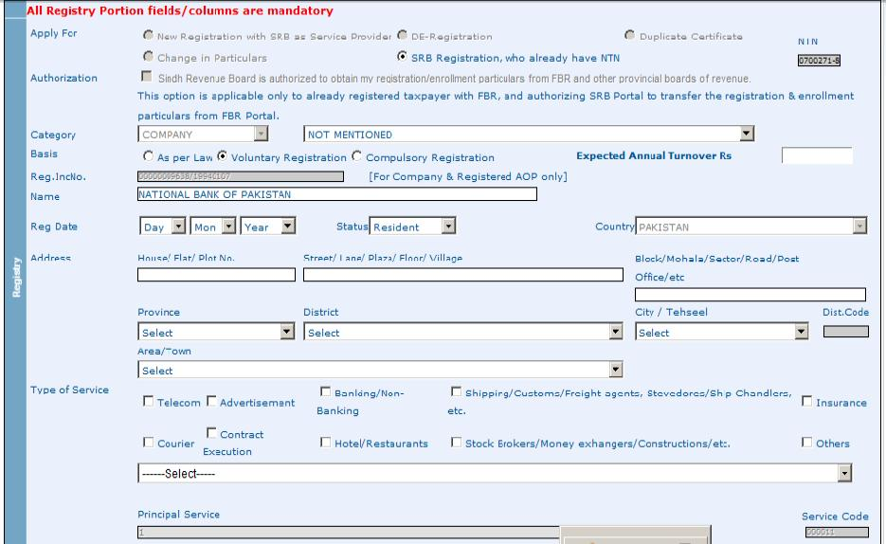
Procedure for Registration STSR
Application for registration is to be filed electronically to SRB in the prescribed form SST-01.

Slide 11
Procedure for Registration Cont’d
SST 01 – Requires particulars of taxpayer, any agents appointed, details of business & bank accounts.

Slide 12
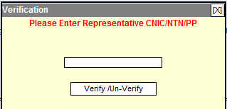
Procedure for Registration Cont’d
SST 01 – Requires a declaration from taxpayer that the information entered is correct before the verifying stage.
After verification and submission of application, the taxpayer will be allotted USER ID and PASSWORD through Email/SMS.
Next step is to e-Enroll.

Slide 13
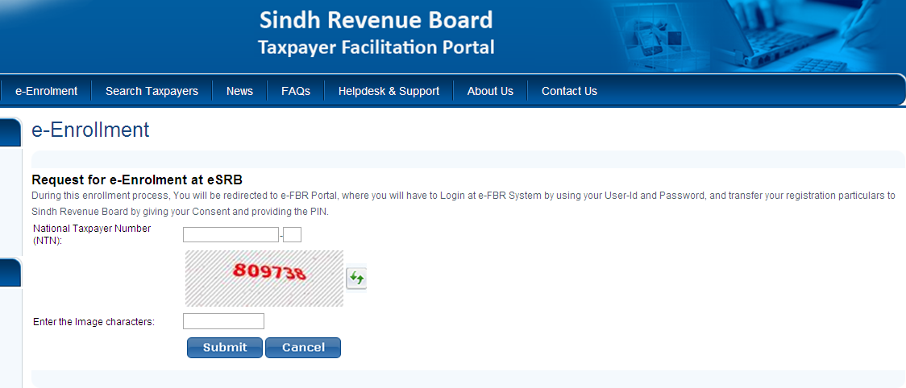
Process for Enrollment
e-Enrollment is the next step after registration.
Existing tax payers are not required to file an application for registration. They do however need to enroll on SRB’s website.

Slide 14
Issues with e-Enrollment
Upon entering NTN number for e-enrollment, the taxpayer is automatically redirected to the FBR website where taxpayer is requested to give consent for transfer of particulars to SRB.
The difficulty posed here is that the particulars in the FBR registry should be updated before request for e-enrollment can be processed.
Where particulars are not up to date, a request for updating needs to be submitted with the FBR and the process is delayed.

Slide 15
Change in Particulars & Transfer of Registration Rule 7 & 8 of the STSR
Change In Particulars
In case of any change in particulars of registration the registered person shall notify SRB via a prescribed form.
SRB may either reject or approve the changes within 30 days of application.
Transfer of Registration
The SRB is empowered to transfer registration of a registered person from the jurisdiction of one Commisionerate to another Commisionerate.
In case of shifting of business activity from jurisdiction of one Commisionerate to another Commisionerate the registered person may also apply to SRB for transfer of registration.

Slide 16
Suspension & Cancellation of Registration Section 25 of STSA & Rule 10 of the STSR
SRB may suspend registration where a registered person is suspected of committing any fraud, deliberate and intentional, non- payment, short payment or evasion of tax.
SRB is required to communicate through a notice stating the reasons for suspension along with the remedial action required to be taken by registered person within a specified time.
SRB may withdraw suspension within 60 days if it is satisfied with the remedial actions taken by the person or otherwise the SRB may
initiate proceedings against the suspended registered person;
reinstate the person’s registration; or
cancel the person’s registration.

Slide 17
De- registration Section 25A of STSA & Rule 9 of STSR
A registered person who ceases to provide taxable services, may apply for de-registration to SRB through form SST – 02.
The application for de- registration must be disposed off within a period of three months from the date of receipt of the application, such period can be extended to another 60 days.
The date of de- registration would be later of the date as may be specified in de- registration application or on the date all the dues outstanding are deposited .

Slide 18
Records
Notes:
This is a predetermined divider slide and should not be modified.

Slide 19
Maintaining Records Section 26 of STSA
Every registered person providing taxable services shall maintain and keep following records at his business premises or registered office-
Records of taxable services rendered by a registered person or his agent
Records of exempt services
Records of tax invoices
Records of filed sales tax returns
Any other record specified by SRB.
A registered person is required to maintain any records or documents under STSA for a period of –
Five years; or
Till the final decision in any proceeding is finalized under the STSA.

Slide 20
Maintaining Record Cont’d
A registered person can use only those business bank accounts as declared to SRB.
A registered persons, whose accounts are subject to audit under the Companies Ordinance, 1984, shall be required to submit a copy of the annual audited accounts, along with a certificate by the auditors certifying the payment of sales tax due and any deficiency in the sales tax paid by the registered person.

Slide 21
Invoicing requirements
A service provider, rendering taxable services shall issue serially numbered sales tax invoices mentioning –
The description and type of services
Value of services
Name and address of the person to whom the services are provided.
Customers who have been extended credit facilities to, may be issued serially numbered sales tax invoices at the end of each month for the taxable services provided during that month.

Slide 22
Returns
Notes:
This is a predetermined divider slide and should not be modified.

Slide 23
Sales Tax Returns
Every registered person is required to furnish a true and correct monthly sales tax return in the prescribed form not later than the due date i .e. 15th day of the month following the end of the tax period.
Every person who is required to file return shall file such return with its annexure on SRB web portal by 18th of every month and the tax due shall be deposited by the 15th of every month .
SRB may also require any registered person or class of persons to submit returns on quarterly or annual basis.
If there is a change in the rate of tax during a tax period, a separate return in respect of each portion of tax period showing the application of different rates of tax shall be furnished.

Slide 24
Sales Tax Returns Cont’d
Revised Return
A registered person may file a revised return within 120 days of filing of a return to correct any omission or wrong declaration or to deposit any amount of tax short paid.
In case of correction of any omission or wrong declaration a revised return can be filed after permission from SRB.
In case of payment of tax with revised return due to short payment of tax with original return, no permission from SRB is required.
Special Return
The Assistant Commissioner may require any person whether, registered or not, to furnish a return in a prescribed form.
Final Return
A registered person before de-registration would be required to file a final return to the Commissioner SRB in the specified form.

Slide 25
Sales Tax Returns Cont’d
Return deemed to have been made
A return purported to be made on behalf of a person by his duly appointed representative or agent shall, for all purposes, be deemed to have been made by such person or under his authority unless proved otherwise.

Slide 26
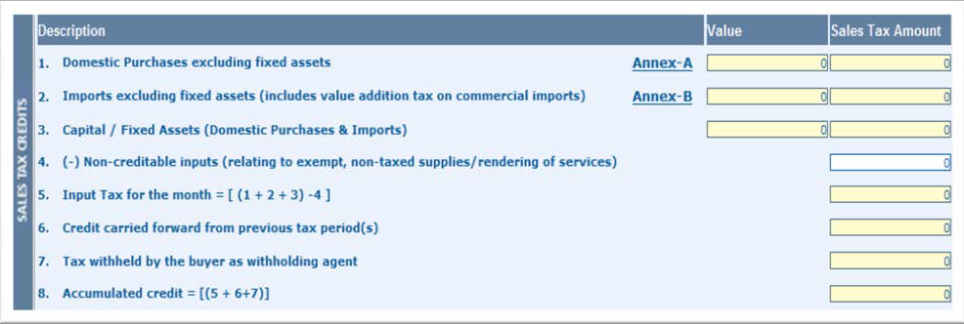
Return with Annexures
Sales tax is e-filed through the sales tax return form SST - 03
Sales Tax Credit Section

Slide 27
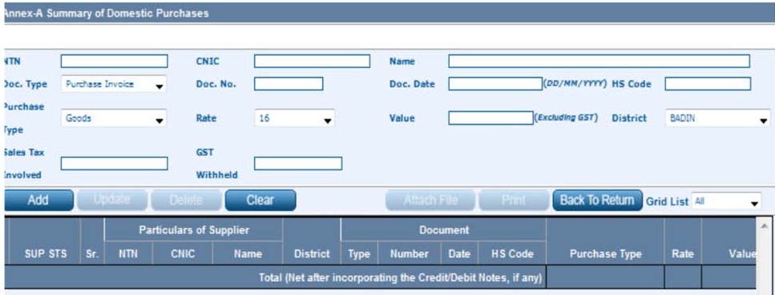
Return with Annexures
Annexure A is provided to record domestic purchases on which input tax adjustments are to be claimed.
Annexure – A “Domestic Purchases”

Slide 28
Return with Annexures
Annexure B records input tax paid on imports made in a period.
Annexure – A “Domestic Purchases”

Slide 29
Return with Annexures
SST 03 – Sales tax debits section

Slide 30
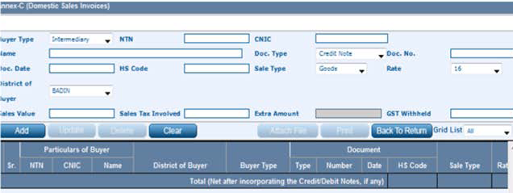
Return with Annexures
Annexure C – Details of services rendered and tax thereon.

Slide 31
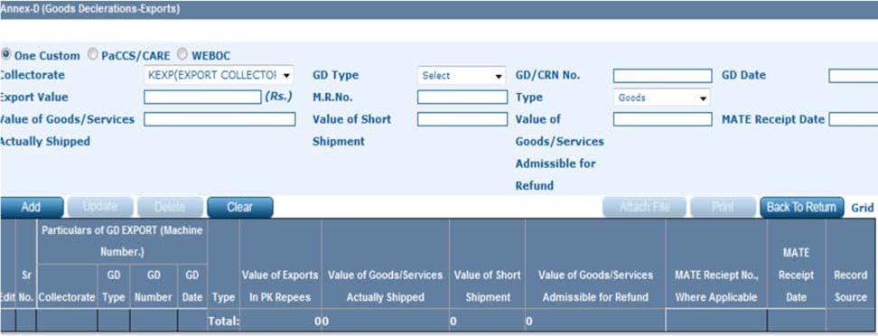
Return with Annexures
Annexure D – Details of services exported and tax thereon.

Slide 32
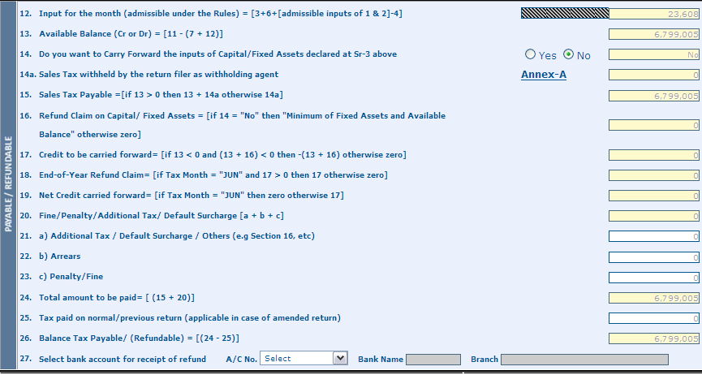
Return with Annexures
SST 03 – Row No. 12 was previously not taking into account the amount shown in Row No. 4 of the return, i.e. Non-creditable inputs.
The issue was resolved through SRB notification dated 7 September 2011.

Slide 33
Sales Tax Return Multiple Returns
Following Persons are required to file returns with SRB and FBR:
Person providing taxable service in Provinces other than Sindh-
Will be required to file two returns at a time, i.e. with eSRB in respect of services rendered in Province of Sindh and the other with eFBR in respect of services rendered in other provinces (including Islamabad).
Person involved in rendering taxable service and supply of taxable goods side by side
Will also be required to file two returns at a time, i.e. with eSRB in respect of services rendered in Province of Sindh and the other with eFBR in respect of supply of taxable goods either in Sindh or in other parts of Pakistan.
To claim input tax in SRB or FBR return, the aforementioned persons have to bifurcate purchase invoices/imports related to SRB or FBR revenue.
Cases where specific allocation is not possible?
Entering of purchase invoices/imports in both portals?
Inadmissible input tax?

Slide 34
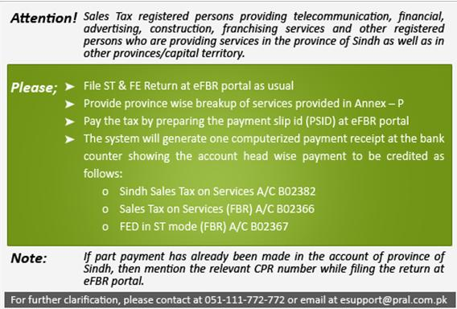
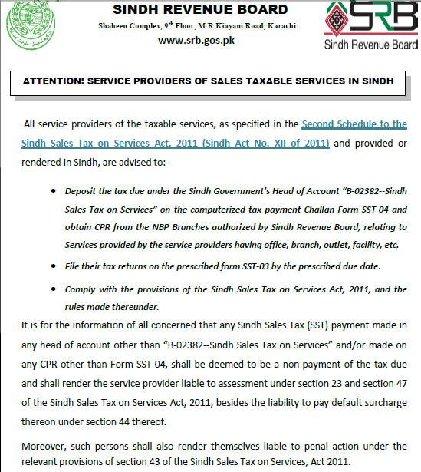
Issues in e-Filing returns with both FBR & SRB
Contradiction between FBR and SRB on submission of tax payment.
Notes:
The announcement on the FBR website clearly states that payment made to the GOS on account of sales made in Sindh can be included in the return by mentioning the relevant CPR number .
However, no option as such appears in the FBR’s return.
However, SRB has vehemently stated that payment of sales tax on services rendered in Sindh should be deposited in the prescribed head of account and non-compliance will be liable to penal action.

Slide 35
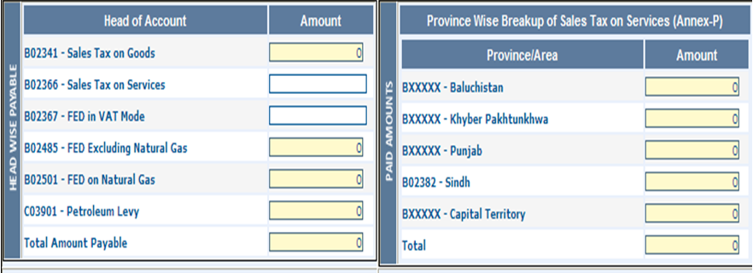
Issues in e-Filing returns with both FBR & SRB- Annexure P

Slide 36
Issues in e-Filing returns with both FBR & SRB- Annexure P
Annexure P is inserted to allocate the services related revenue to each province directly.
The idea is allocation of payable tax to each province on the basis of revenue declared in Annexure P after adjustment of input tax in same ratio.
Works properly in case of exclusive taxable service providers (i.e. where no supply of goods is involved)
In case of persons rendering of services as well as supplying goods the input allocation is not made accordingly.

Slide 37
Agents/Representatives/e-Intermediaries
Notes:
This is a predetermined divider slide and should not be modified.

Slide 38
Agents/Representatives/e-Intermediaries
Agent
Agent means a person who is authorized to act on behalf of another (called the principal) to create a legal relationship with a third party.
Generally section 67 of STSA refers agent to a guardian / trustee/ director / manager / secretary / accountant / a Govt. officer/ a partner, related to an individual, a company , a trust , an AOP, Provincial, Local or Federal Govt., NGO etc.
A registered person may also expressly or impliedly authorize another person to be his agent for all or any purpose of SSTSA.
Liabilities of an Agent
Every agent of a person shall be responsible for performing any duties or obligations imposed under the SSTSA, including the payment of tax.
Generally liabilities of an agent in respect of recovery of tax under SSTSA from principal, is limited to the extent of money or assets of principal in possession or control of the agent.

Slide 39
Agents/Representatives/e-Intermediaries Cont’d
Liability of the registered person for the acts of his agent
A registered person shall be responsible for any and all acts done by his agent
Authorized Representative
A registered person who is required to appear before the Appellate Tribunal or an officer of the SRB in connection with any proceedings may in writing authorize a Tax Practitioner registered under Income tax rules, Sales tax rules, Customs Act, an advocate enrolled with Bar and an Accountant.
The following persons shall not be entitled to represent a taxpayer
person who has been convicted in a criminal proceedings
a person who has been dismissed or compulsorily retired from service;
a person who is an un-discharged insolvent; and
a person who has been found guilty of misconduct.

Slide 40
Agents/Representatives/e-Intermediaries Coont’d
E-intermediaries
A registered person may authorize an e-intermediary to electronically file returns or any other documents on his behalf.
The return or such other documents filed by an e-intermediary on behalf of a registered person shall be deemed to have been filed by that registered person.
Where an e-intermediary, authorized by a registered person knowingly or willfully submits false or incorrect information or document or declaration with an intent to avoid payment of tax due or any part thereof, such e-intermediary shall be jointly and severally responsible for recovery of the amount of tax short paid

Slide 41
THANKYOU
Notes:
The graphic on the divider slide is an AutoShape with a solid fill. To insert an appropriate image, ensure you have the image you wish to use (ideally a .jpg or a .png file) in an accessible folder. The image should have a ratio of 2:1 to ensure it does not appear distorted.
Click View>Master>Slide Master.
Right-click on the graphic and select Format AutoShape.
Click Fill>Color and Lines. Select the drop-down arrow next to Color and select the Fill Effects menu. From the Picture tab, click on Select Picture.
Navigate to the folder containing the image you wish to insert in the divider slide graphic. Highlight the image and click Insert.
You can now preview the image before continuing. If you are happy with how it looks, click OK to continue. Otherwise, repeat the process until you are happy with your selected image.
To exit from Slide Master View, click View>Normal.
The change you made to the divider slide graphic should now be visible on the slide.

