Slide 1
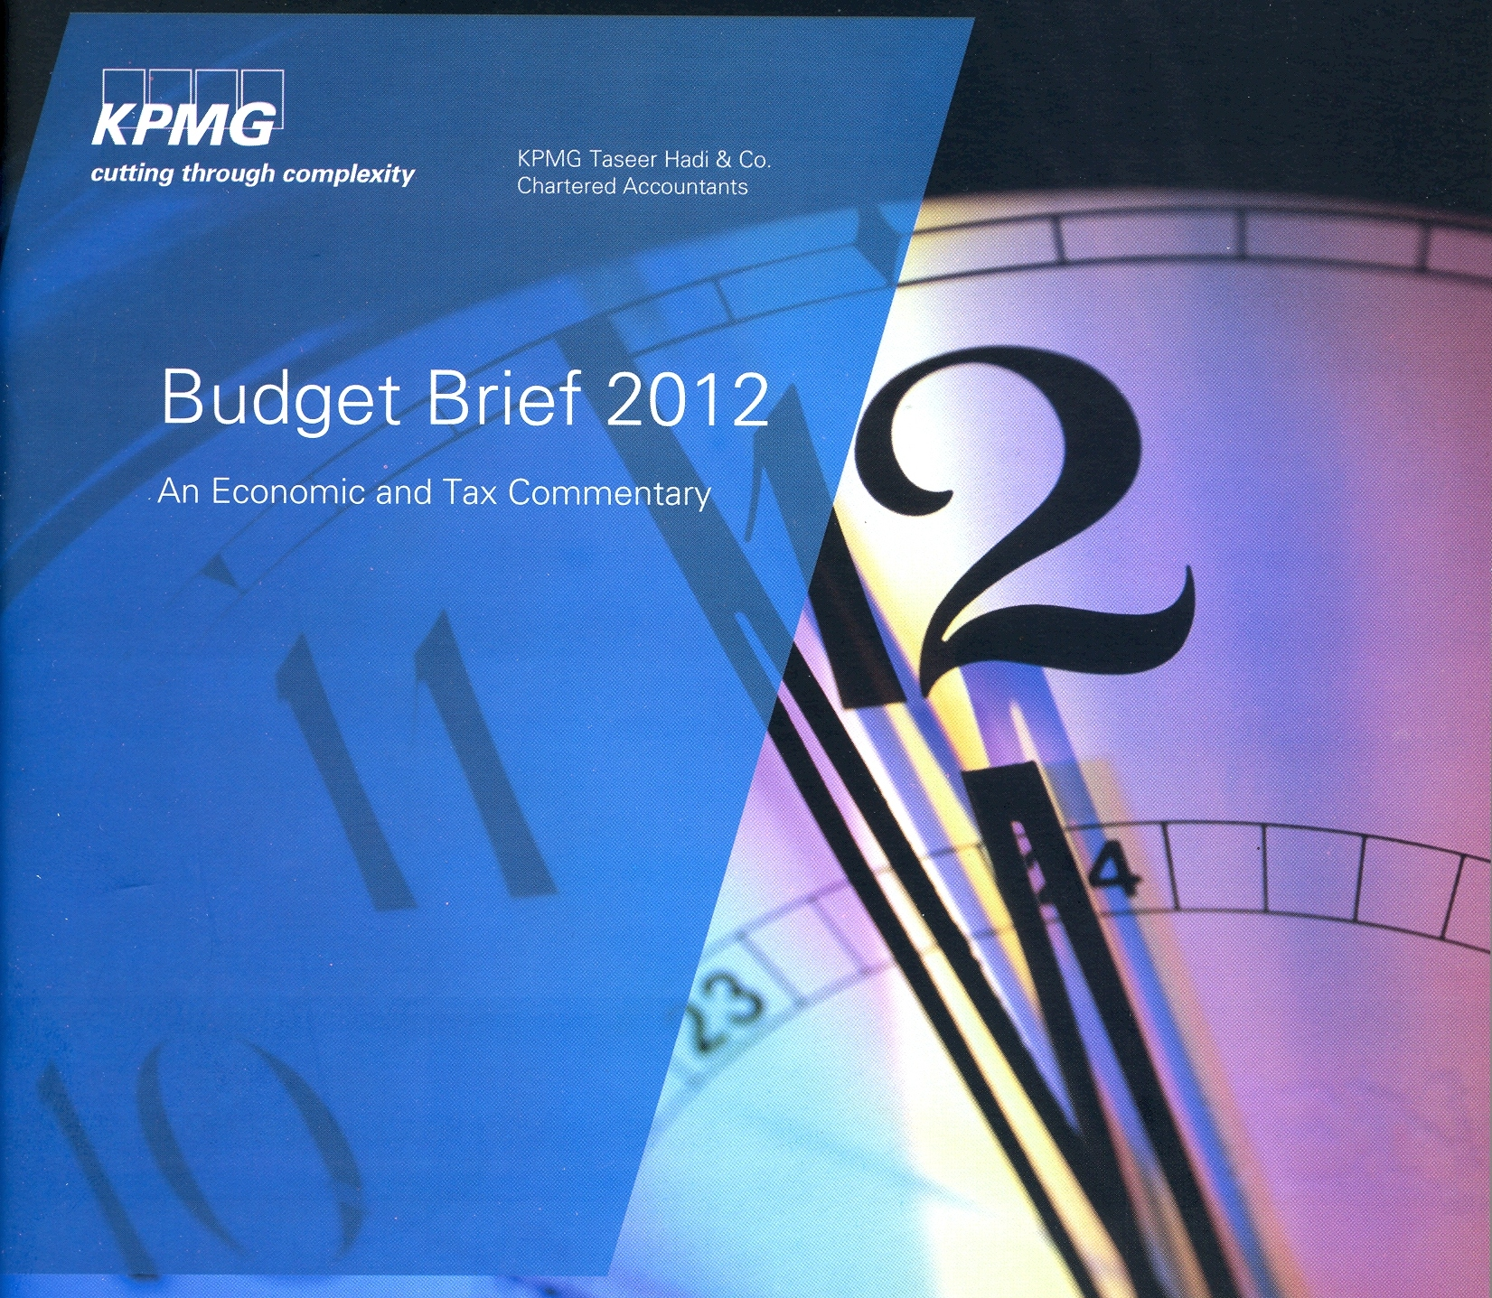
Impact of Budget on Economy
Syed Masoud Ali Naqvi
Monday, 4th June 2011
Marriott Hotel, Karachi.

Slide 2
Impact of Budget on Economy
Table of Contents
Key Objectives of Budget
Budgetary Targets and Revised Estimates
GDP Growth
Trade, Current Account and Overall Fiscal Deficit
Public Debt
Social Indicators
Exchange Reserves
Inflation
Average Retail Prices
Comparative Economic Indicators 2012
Key Challenges 2012

Slide 3
Impact of Budget on Economy
Key Objectives for the Budget 2011-12
Further reduction Fiscal Deficit. |  | Reduction of inflation to single digit. |  | Develop a broad equitable and stable Revenue Mobilization system.
Maintaining and further developing safety nets. |  | Focus on PSDP on infra-structure and Human Resource Development. |  | Restructuring of Loss incurring PSE.
Progressive elimination of untargeted subsidies. |  | KEY OBJECTIVES FOR THE BUDGET 2011-12 |  | Reduction of Public Debt to sustainable level.

Slide 4
Impact of Budget on Economy
Budgetary Targets and Revised Estimates
Description | Budget 2011-12 | Revised 2011-12 | Budget 2012-13
Real GDP Growth (%) | 4.2 | 3.7 | 4.3
Inflation (%) | 12.0 | 11.5 | 9.5
 | (as percentage of GDP unless otherwise indicated)
Total Revenue | 13.6 | 12.9 | 14.3
- Tax Revenue | 10.2 | 10.3 | 11.1
- FBR Tax Revenue | 9.3 | 9.5 | 10.1
- Non Tax Revenue | 3.4 | 2.6 | 3.2
Total Expenditure | 17.7 | 20.3 | 19.0
- Current Expenditure | 14.1 | 16.3 | 14.5
- Development Expenditure | 3.6 | 3.9 | 4.4
Fiscal Balance (Overall Deficit) | -4.0 | -7.4* | -4.7
Revenue Balance | -0.5 | -3.4 | -0.3
Total Public Debt | 56.7 | 60.0 | 56.5
GDP at market prices (Rs. In billion) | 21,041 | 20,654 | 23,655
Bank borrowings (Rs. in billion) | 304 | 939 | 484

Slide 5
Impact of Budget on Economy
GDP Growth
 | 11-12 (P) | 10-11 | 09-10 | 08-09 | 07-08 | 06-07 | 05-06 | 04-05 | 03-04 | 02-03
Nominal GDP US$ billion | 227.8 | 210.8 | 177.0 | 162.1 | 163.8 | 143.0 | 127.4 | 109.5 | 98.0 | 82.4
Nominal GDP Rs.million | 20,654 | 18,033 | 14,804 | 12,724 | 10,243 | 8,673 | 7,623 | 6,500 | 5,641 | 4,876
Real GDP Growth % | 3.7 | 3.0 | 3.1 | 1.7 | 3.7 | 6.8 | 5.8 | 9.0 | 7.5 | 4.7
Sectoral GDP Growth %
Agriculture | 3.1 | 2.4 | 0.6 | 4.0 | 1.0 | 4.1 | 6.3 | 6.5 | 2.4 | 4.1
Manufacturing | 3.6 | 3.0 | 5.5 | -3.6 | 4.8 | 8.3 | 8.7 | 15.5 | 14.0 | 6.9
Services | 4.0 | 4.4 | 2.6 | 1.7 | 6.0 | 7.0 | 6.3 | 8.5 | 5.9 | 5.2
Sectoral Share in GDP %
Agriculture | 21.3 | 21.8 | 21.2 | 20.9 | 21.1 | 21.9 | 22.5 | 22.4 | 22.9 | 24.0
Manufacturing | 19.2 | 18.2 | 18.6 | 18.7 | 18.7 | 19.0 | 18.8 | 18.3 | 17.3 | 16.3
Services | 52.9 | 52.9 | 52.4 | 53.3 | 53.5 | 51.8 | 51.7 | 51.3 | 51.6 | 52.4

Slide 6
Impact of Budget on Economy
GDP Growth

Slide 7
Impact of Budget on Economy
Overall Deficit
 | 11-12 (P) | 10-11 | 09-10 | 08-09 | 07-08 | 06-07 | 05-06 | 04-05 | 03-04 | 02-03
(US $ million)
Exports | 20,474 | 25,356 | 19,673 | 19,121 | 20,427 | 17,278 | 16,553 | 14,482 | 12,396 | 10,889
Imports | 33,157 | 35,872 | 31,209 | 31,747 | 35,397 | 26,989 | 25,017 | 18,996 | 13,604 | 11,333
Trade Balance | -12,683 | -10,516 | -11,536 | -12,626 | -14,970 | -9,711 | -8,464 | -4,514 | -1,208 | -444
Services – net | -2,347 | -1,940 | -1,690 | -3,381 | -6,457 | -4,170 | -4,432 | -3,293 | -1,387 | 83
Current Transfer – net | 14,291 | 15,687 | 12,562 | 11,154 | 11,476 | 10,585 | 10,548 | 8,659 | 6,116 | 5,737
(Workers’ remittances) | 10,877 | 11,201 | 8,906 | 7,811 | 6,449 | 5,494 | 4,600 | 4,168 | 3,871 | 4,237
Income Account Balance – net | -2,655 | -3,017 | -3,281 | -4,407 | -3,923 | -3,582 | -2,667 | -2,386 | -2,207 | -2,211
Current Account | -3,394 | 214 | -3,945 | -9,260 | -13,874 | -6,878 | -5,015 | -1,534 | 1,314 | 3,165
Overall deficit (% of GDP) | 7.4 | 5.9 | 6.3 | 5.3 | 7.5 | 4.5 | 4.3 | 3.2 | 2.4 | 3.7

Slide 8
Impact of Budget on Economy
Overall Deficit

Slide 9
Impact of Budget on Economy
Public Debt
 | 11-12 (P) | 10-11 | 09-10 | 08-09 | 07-08 | 04-05 | 99-00 | 94-95 | 89-90
Public Debt (Rs. billion) | 12,024 | 10,709 | 8,938 | 7,595 | 6,055 | 4,091 | 3.018 | 1,662 | 801
Domestic | 7,206 | 6,015 | 4,654 | 3,859 | 3,275 | 2,178 | 1,576 | 790 | 374
Foreign currency | 4,818 | 4,694 | 4,284 | 3,736 | 2,780 | 1,913 | 1,442 | 863 | 428
Public Debt (% of GDP) | 58.2 | 59.4 | 60.2 | 59.7 | 59.1 | 62.9 | 78.9 | 89.1 | 91.7
Domestic | 34.9 | 33.4 | 31.4 | 30.3 | 32.0 | 33.5 | 41.2 | 42.3 | 42.8
Foreign currency | 23.3 | 26.0 | 28.9 | 29.4 | 27.1 | 29.4 | 37.7 | 46.8 | 48.9

Slide 10
Impact of Budget on Economy
Public Debt

Slide 11
Impact of Budget on Economy
Social Indicators
 | 11-12 | 10-11 | 09-10 | 08-09 | 07-08 | 06-07 | 05-06 | 04-05 | 03-04 | 02-03
Population (millions) | 180.7 | 177.1 | 173.5 | 163.8 | 161.0 | 158.2 | 155.4 | 152.5 | 149.7 | 146.8
Unemployment rate (%) | 6.0 | 6.0 | 5.5 | 5.2 | 5.2 | 6.2 | 7.6 | 7.7 | 8.3 | 7.8
GNP per capita – US$ | 1,372 | 1,258 | 1,068 | 990 | 1,015 | 904 | 823 | 724 | 663 | 582
Total investment - % of GDP | 12.5 | 13.1 | 15.4 | 18.2 | 22.1 | 22.5 | 22.1 | 19.1 | 16.6 | 16.9
National Savings - % of GDP | 10.7 | 13.2 | 13.1 | 12.5 | 13.6 | 17.4 | 18.2 | 17.5 | 17.9 | 20.8

Slide 12
Impact of Budget on Economy
Social Indicators

Slide 13
Impact of Budget on Economy
Social Indicators

Slide 14
Impact of Budget on Economy
Exchange Reserves
 | 11-12 | 10-11 | 09-10 | 08-09 | 07-08 | 06-07 | 05-06 | 04-05 | 03-04 | 02-03
Exchange reserves (US$ billion) | 16.5 | 17.1 | 12.2 | 11.5 | 16.4 | 12.8 | 11.2 | 11.9 | 10.7 | 5.4
Imports Cover (months) | 5 | 5.7 | 4.6 | 4.3 | 5.6 | 5.7 | 5.4 | 7.5 | 9.4 | 5.7
Rupee to USD parity | 90.8 | 85.6 | 83.8 | 78.5 | 62.5 | 60.6 | 59.9 | 59.4 | 57.6 | 58.5

Slide 15
Impact of Budget on Economy
Exchange Reserves

Slide 16
Impact of Budget on Economy
Inflation
 | 11-12 (Jul-Apr) | 10-11 | 09-10 | 08-09 | 07-08 | 06-07 | 05-06 | 04-05 | 03-04 | 02-03
CPI | 10.8 | 13.9 | 11.7 | 20.8 | 12.0 | 7.8 | 7.9 | 5.5 | 4.6 | 3.1
Food * | 11.1 | 18.0 | 12.9 | 23.1 | 17.6 | 10.3 | 6.9 | 12.5 | 6.0 | 2.9
Non Food * | 10.7 | 10.7 | 8.3 | 13.4 | 7.9 | 6.0 | 8.6 | 7.1 | 3.6 | 3.2
Core * | 10.4 | 9.4 | 7.6 | 11.4 | 8.4 | 5.9 | 7.5 | 6.8 | 3.8 | 2.5
* In 2011-12, base year for calculation of these indices changed to 2007-08.

Slide 17
Impact of Budget on Economy
Inflation

Slide 18
Impact of Budget on Economy
Average retail prices of essential items
 | 2002- 03 | 2003- 04 | 2004- 05 | 2005- 06 | 2006- 07 | 2007- 08 | 2008- 09 | 2009- 10 (Jul – Apr) | 2010- 11 (Jul – Apr) | 2011- 12
Kerosene (per ltr) | 22.48 | 24.95 | 29.11 | 36.19 | 39.09 | 43.44 | 66.79 | 72.65 | 82.12 | 103.09
Gas (100 cf) | 259.35 | 79.45* | 34.60* | 88.92 | 99.79 | 97.17 | 96.19 | 106.81 | 110.72 | 130.63
Petrol super (per ltr) | 33.08 | 33.69 | 40.74 | 55.12 | 56.00 | 57.83 | 67.68 | 67.57 | 73.16 | 91.33
Electricity charges (upto 50 units) | 2.45 | 2.54 | 2.47 | 2.14 | 2.49 | 2.76 | 3.18 | 3.64 | 4.29 | 1.87
Tele local call charges (per call) | 2.31 | 2.31 | 2.31 | 2.31 | 2.31 | 2.31 | 2.38 | 2.62 | 3.59 | 3.59
Wheat flour (avg quality per kg) | 10.14 | 11.71 | 13.28 | 13.06 | 13.64 | 18.07 | 25.64 | 28.77 | 295.71 | 301.52
Basmati rice (broken per kg) | 18.07 | 19.04 | 20.19 | 20.16 | 23.11 | 37.77 | 47.12 | 43.92 | 49.46 | 59.42
Beef Cow/buffalo (with bone per kg) | 61.21 | 75.45 | 94.83 | 106.84 | 117.87 | 123.30 | 143.82 | 174.49 | 217.91 | 250.27
* The units were changed from 100cm to 100 cf.
Continued on next Slide

Slide 19
Impact of Budget on Economy
Average retail prices of essential items
 | 2002-03 | 2003-04 | 2004-05 | 2005-06 | 2006-07 | 2007-08 | 2008-09 | 2009-10 (Jul – Apr) | 2010-11 (Jul – Apr) | 2011- 12
Chicken (Farm per kg) | 54.01 | 57.50 | 66.43 | 66.08 | 74.16 | 83.39 | 103.12 | 126.22 | 130.89 | 150.45
Mutton Goat (avg quality per kg) | 124.59 | 154.31 | 185.19 | 202.10 | 224.07 | 236.49 | 263.03 | 316.52 | 405.36 | 477.48
Eggs Hen Farm (per Dozen) | 30.69 | 30.03 | 37.45 | 35.07 | 38.31 | 49.45 | 58.80 | 65.67 | 74.67 | 89.43
Sugar (open mkt. per kg) | 20.77 | 19.01 | 23.45 | 31.16 | 31.85 | 27.92 | 38.72 | 57.11 | 73.82 | 62.43
Milk (fresh per ltr) | 18.35 | 19.23 | 21.28 | 23.90 | 26.72 | 30.45 | 36.62 | 42.32 | 49.02 | 57.42
Tea super quality (per 250 gm packet) | 61.50 | 64.68 | 61.99 | 62.62 | 68.39 | 68.28 | 97.54 | 110.77 | 120.46 | 133.77
Cooking oil Dalda (per 2.5 ltr) | 199.68 | 203.98 | 204.99 | 204.41 | 224.48 | 316.32 | 371.38 | 359.05 | 424.05 | 497.00
* The units were changed from 100cm to 100 cf.

Slide 20
Impact of Budget on Economy
Comparative Economic Indicators 2012
Description | Bangladesh | India | Sri Lanka | Pakistan
GDP growth rates | 5.9% | 6.9% | 7.5% | 3.7%
GDP (Nominal, USD billion) | 126.41 | 1,572.05 | 64.05 | 227.80
GDP per capita (USD) | 748 | 1,299 | 3,097 | 1,372
Overall fiscal deficit (% of GDP) | 5.0% | 5.9% | 12.4% | 7.4%
Gross public debt (% of GDP) | 27.7% | 68.0% | 85.0% | 60.0%
Inflation (Average Consumer Price Change %) | 7.3% | 6.9% | 6.2% | 11.5%
Population (million) | 169 | 1,210 | 21 | 181
Unemployment rate | 5.1% | 9.4% | 5.0% | 6.0%
Investments (% of GDP) | 27.4% | 40.3% | 28.0% | 12.5%
Gross National Savings (% of GDP) | 26.2% | 36.5% | 23.9% | 10.7%
Exchange Reserves (USD billion) | 5.28 | 284.10 | 5.63 | 16.10
Exchange Rate LCU:USD | 74.90 | 52.67 | 114.65 | 90.80
Workers Remittances (USD billion) | 10.61 | 36.77 | 6.50 | 12.00

Slide 21
Impact of Budget on Economy
Key Challenges
Low domestic resource mobilization
Weak Institutions
Economic Inequality
High Ethnic diversity
Fiscal indiscipline
Low and declining productivity
Lower growth
High inflation
Inadequate investments and savings rate

Slide 22
Impact of Budget on Economy
Key Challenges
Increasing reliance on external and domestic borrowings – sustainability
Reduction in FDIs
Struggle with macro-economic stabilization due to unsustainable fiscal policies
Legacy of Economic Distortions
Pressure of Demography
Ailing Public sector Enterprises
Security situation and war against terrorism
External shocks
Geo-political tensions

Slide 23
THANK YOU !

Slide 24
Presenter’s contact details
SYED MASOUD ALI NAQVI
Country Senior Partner
KPMG Taseer Hadi & Co.
+92 (21) 3568 5847
mnaqvi@kpmg.com
www.kpmg.com.pk

Slide 25
Impact of Budget on Economy
Budget at a glance
 | (Rupees in Billions)
REVENUE | Budget Estimate 2011-12 | % | Revised Estimate 2011-12 | % | Budget Estimate 2012-13 | %
Tax Revenue
Direct Taxes
Income tax | 718.6 | 26.0 | 730.0 | 23.5 | 914.0 | 28.5
Others | 25.0 | 0.9 | 15.0 | 0.5 | 18.0 | 0.6
 | 743.6 | 26.9 | 745.0 | 24.0 | 932.0 | 29.1
Indirect Taxes
Customs | 206.4 | 7.5 | 215.0 | 6.9 | 247.5 | 7.7
Sales tax | 836.7 | 30.2 | 852.0 | 27.4 | 1,076.5 | 33.7
Federal excise | 165.6 | 6.0 | 140.0 | 4.5 | 125.0 | 3.9
Carbon Surcharge on POL/CNG | 120.0 | 4.3 | 69.0 | 2.2 | 120.0 | 3.7
Others | 1.9 | 0.1 | 3.5 | 0.1 | 2.6 | 0.1
 | 1,330.6 | 48.1 | 1,279.5 | 41.1 | 1,571.6 | 49.1
Total Tax Revenue: | 2,074.2 | 75.0 | 2,024.5 | 65.1 | 2,503.6 | 78.2

Slide 26
Impact of Budget on Economy
Budget at a glance
 | (Rupees in Billions)
REVENUE | Budget Estimate 2011-12 | % | Revised Estimate 2011-12 | % | Budget Estimate 2012-13 | %
Total Tax Revenue B/f : | 2,074.2 | 75.0 | 2,024.5 | 65.1 | 2,503.6 | 78.2
Non Tax Revenue | 658.0 | 23.8 | 512.2 | 16.5 | 730.3 | 22.8
 | 2,732.2 | 98.8 | 2,536.7 | 81.6 | 3,233.9 | 101.0
Less Provincial Share | 1,203.3 | 43.5 | 1,208.6 | 38.9 | 1,458.9 | 45.6
 | 1,528.9 | 55.3 | 1,328.1 | 42.7 | 1,775.0 | 55.4
Net Capital Receipts | 395.7 | 14.3 | 525.5 | 16.9 | 477.8 | 14.9
External Receipts | 413.9 | 15.0 | 226.2 | 7.3 | 386.9 | 12.1
Change in Provincial cash balance | 124.9 | 4.4 | 90.7 | 2.9 | 79.5 | 2.5
Bank Borrowings | 303.5 | 11.0 | 939.2 | 30.2 | 483.8 | 15.1
TOTAL REVENUE : | 2,766.9 | 100.0 | 3,109.7 | 100.0 | 3,203.0 | 100.0

Slide 27
Impact of Budget on Economy
Budget at a glance
 | (Rupees in Billions)
EXPENDITURE | Budget Estimate 2011-12 | % | Revised Estimate 2011-12 | % | Budget Estimate 2012-13 | %
Current Expenditure
General Public Services
Debt Servicing | 1,034.2 | 37.4 | 980.7 | 31.5 | 1,141.7 | 35.6
Grants & transfers | 295.0 | 10.7 | 251.4 | 8.1 | 312.3 | 9.8
Superannuation and pensions | 96.1 | 3.5 | 135.4 | 4.4 | 129.1 | 4.0
Subsidies | 166.4 | 6.0 | 512.3 | 16.5 | 209.0 | 6.6
Others | 68.3 | 2.4 | 18.2 | 0.5 | 84.7 | 2.6
 | 1,660.0 | 60.0 | 1,898.0 | 61.0 | 1,876.8 | 58.6
Defence Affairs & Services | 495.2 | 17.9 | 510.2 | 16.4 | 545.4 | 17.0
Economic Affairs | 50.3 | 1.8 | 72.2 | 2.3 | 53.6 | 1.7
Public Order and Safety Affairs | 59.6 | 2.2 | 61.9 | 2.0 | 70.2 | 2.2
Education Affairs & Services | 39.5 | 1.4 | 45.2 | 1.5 | 47.9 | 1.5
Others | 10.3 | 0.4 | 44.4 | 1.4 | 18.0 | 0.6
 | 2,314.9 | 83.7 | 2,631.9 | 84.6 | 2,611.9 | 81.6

Slide 28
Impact of Budget on Economy
Budget at a glance
 | (Rupees in Billions)
EXPENDITURE | Budget Estimate 2011-12 | % | Revised Estimate 2011-12 | % | Budget Estimate 2012-13 | %
Total Expenditure B/f : | 2,314.9 | 83.7 | 2,631.9 | 84.6 | 2,611.9 | 81.6
Development Expenditure
PSDP | 355.0 | 12.8 | 356.0 | 11.5 | 436.8 | 13.6
Others | 97.0 | 3.5 | 121.8 | 3.9 | 154.3 | 4.8
 | 452.0 | 16.3 | 477.8 | 15.4 | 591.1 | 18.4
TOTAL EXPENDITURE : | 2,766.9 | 100.0 | 3,109.7 | 100.0 | 3,203.0 | 100.0

