Slide 1
Impact of Budget on Economy
KPMG Taseer Hadi & Co. Chartered Accountants
Masoud Naqvi
Saturday, 07th June 2014
Tax Bar Association, Karachi

Slide 2
Impact of Budget on Economy
Key Objectives for the Budget 2013-14
Reduction of Fiscal Deficit
8.2 to 5.8%
Arresting Inflationary Pressure
8.6 to 7.7%
Raising Tax Revenues
By 16.4 percent
Raising Investment
for growth 14.6 from 13.99
Protecting
the poor
BISP - 75 bn
Creating new jobs
Unemployment 6.2 percent
Reforming
Public Sector Enterprise
Reducing
untargeted subsidies
Rs. 201 bn against Rs. 270 bn
Resolving
the energy crisis
1700 MW added 11 percent increased generation
Improving
balance of payments
Current account deficit $2162 bn (0.95 %) from $ 1574 bn (0.7 of GDP)

Slide 3
Impact of Budget on Economy
Key Objectives for the Budget 2014-15
Reduction of Fiscal Deficit
Arresting Inflationary Pressure
Raising Tax Revenues
Raising Investment
for growth
Protecting
the poor
Creating new jobs
Public Debt Management
Development and Promotion of ICT Sector
Strengthening Social Safety Nets
Continued focus on
the energy crisis
Improving
balance of payments and Export Promotion

Slide 4
Impact of Budget on Economy
Budget at a glance
 | Budget Estimate 2013-14 |  | % |  | Revised Estimate 2013-14 |  | % |  | Budget Estimate 2014-15 |  | %
 | ------------------(Rupees in billion) ----------------
Revenue
Tax Revenue
FBR:
- Direct | 976 |  | 26.6 |  | 891 |  | 23.7 |  | 1,180 |  | 28.0
- Indirect | 1,499 |  | 40.9 |  | 1,384 |  | 36.7 |  | 1,630 |  | 38.6
Others | 196 |  | 5.3 |  | 239 |  | 6.3 |  | 319 |  | 7.6
 | 2,671 |  | 72.8 |  | 2,514 |  | 66.7 |  | 3,129 |  | 74.2
Non Tax Revenue | 749 |  | 20.4 |  | 1,083 |  | 28.7 |  | 816 |  | 19.4
 | 3,420 |  | 93.3 |  | 3,597 |  | 95.5 |  | 3,945 |  | 93.6
Public Accounts Receipts - Net | 247 |  | 6.7 |  | 170 |  | 4.5 |  | 271 |  | 6.4
 | 3,667 |  | 100.0 |  | 3,767 |  | 100.0 |  | 4,216.0 |  | 100.0

Slide 5
Impact of Budget on Economy
Budget at a glance
 | Budget Estimate 2013-14 |  | % |  | Revised Estimate 2013-14 |  | % |  | Budget Estimate 2014-15 |  | %
 | ------------------(Rupees in billion) ----------------
Less: Provincial Share | 1,502 |  | 41.0 |  | 1,413 |  | 37.5 |  | 1,720 |  | 40.8
Net Revenue | 2,165 |  | 59.0 |  | 2,354 |  | 62.5 |  | 2,496 |  | 59.2
Expenditure
Development | 789 |  | 21.5 |  | 859 |  | 22.8 |  | 839 |  | 19.9
Current | 3,437 |  | 93.7 |  | 3,404 |  | 90.4 |  | 3,527 |  | 83.7
 | 4,226 |  | 115.2 |  | 4,263 |  | 113.2 |  | 4,366 |  | 103.6
Deficit | 2,061 |  | 56.2 |  | 1,909 |  | 50.7 |  | 1,870 |  | 44.4

Slide 6
Impact of Budget on Economy
Budget at a glance
 | Budget Estimate 2013-14 |  | % |  | Revised Estimate 2013-14 |  | % |  | Budget Estimate 2014-15 |  | %
 | ------------------(Rupees in billion) ----------------
Funded by
Capital Receipts | 487 |  | 23.6 |  | 636 |  | 33.3 |  | 484 |  | 25.9
Domestic Debt - Banks | 975 |  | 47.3 |  | 376 |  | 19.7 |  | 227 |  | 12.1
External Debt | 576 |  | 27.9 |  | 714 |  | 37.4 |  | 870 |  | 46.5
Surplus from Provinces | 23 |  | 1.1 |  | 183 |  | 9.6 |  | 289 |  | 15.5
 | 2,061 |  | 100.0 |  | 1,909 |  | 100.0 |  | 1,870 |  | 100.0

Slide 7
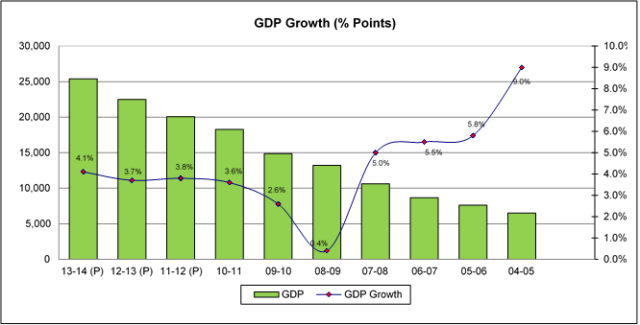
Impact of Budget on Economy
Economic Analysis – GDP Growth

Slide 8
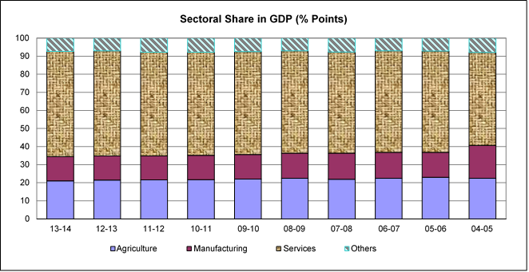
Impact of Budget on Economy
Economic Analysis – GDP Growth

Slide 9
Impact of Budget on Economy
Economic Analysis – Public Debt
 | 13-14 (P) | 12-13 (P) | 11-12 (P) | 10-11 (P) | 09-10 | 08-09 | 07-08 | 04-05 | 99-00
Public Debt (Rs. billion) | 15,534 | 14,366 | 12,653 | 10,700 | 8,911 | 7,629 | 6,044 | 4,091 | 3,018
Domestic | 10,823 | 9,517 | 7,637 | 6,016 | 4,651 | 3,852 | 3,266 | 2,178 | 1,576
Foreign currency | 4,711 | 4,849 | 5,016 | 4,684 | 4,260 | 3,777 | 2,778 | 1,913 | 1,442
Public Debt (% of GDP) | 61.2 | 63.9 | 63.1 | 58.5 | 59.9 | 57.8 | 56.8 | 62.9 | 78.9
Domestic | 42.6 | 42.3 | 38.1 | 32.9 | 31.3 | 29.2 | 30.7 | 33.5 | 41.2
Foreign currency | 18.5 | 21.6 | 25.0 | 25.6 | 28.7 | 28.6 | 26.1 | 29.4 | 37.7

Slide 10
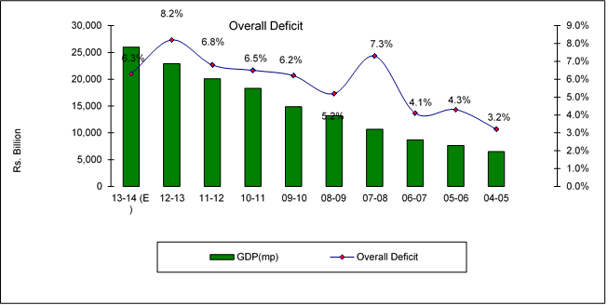
Impact of Budget on Economy
Economic Analysis – Overall Deficit

Slide 11
Impact of Budget on Economy
Economic Analysis – Social Indicators
 | 13-14 | 12-13 | 11-12 | 10-11 | 09-10 | 08-09 | 07-08 | 06-07 | 05-06 | 04-05
Population (millions) | 188 | 184.4 | 180.7 | 177.1 | 173.5 | 163.8 | 161.0 | 158.2 | 155.4 | 152.5
Unemployment rate (%) | 6.2 | 6.2 | 6.0 | 6.0 | 5.5 | 5.2 | 5.2 | 6.2 | 7.6 | 7.7
GNP per capita – US$ | 1,386.2 | 1,339.5 | 1,320.5 | 1,274.1 | 1,072.4 | 1,026.1 | 1,053.2 | 979.9 | 897.4 | 724.1
Total investment - % of GDP | 14 | 14.6 | 15.1 | 14.1 | 15.8 | 17.5 | 19.2 | 18.8 | 19.3 | 19.1
National Savings - % of GDP | 12.9 | 13.5 | 13 | 14.2 | 13.6 | 12.0 | 11.0 | 14.0 | 15.2 | 17.5

Slide 12
Impact of Budget on Economy
Economic Analysis – Exchange Reserves
 | 13-14 | 12-13 | 11-12 | 10-11 | 09-10 | 08-09 | 07-08 | 06-07 | 05-06 | 04-05
Exchange reserves (US$ billion) | 13.6 | 11.5 | 16.5 | 17.1 | 12.2 | 11.5 | 16.4 | 12.8 | 11.2 | 11.9
Imports Cover (months) | 3.4 | 3.5 | 5 | 5.7 | 4.6 | 4.3 | 5.6 | 5.7 | 5.4 | 7.5
Rupee to USD parity | 98.77 | 99.66 | 89.2 | 85.5 | 83.8 | 78.5 | 62.5 | 60.6 | 59.9 | 59.4

Slide 13
Impact of Budget on Economy
Economic Analysis – Inflation
 | 13-14 (Jul-Apr) | 12-13 | 11-12 | 10-11 | 09-10 | 08-09 | 07-08 | 06-07 | 05-06 | 04-05
CPI | 8.7 | 7.7 | 11.0 | 13.7 | 10.1 | 17.0 | 12.0 | 7.8 | 7.9 | 5.5
Food * | 9.3 | 7.1 | 11.1 | 18.0 | 12.9 | 23.1 | 17.6 | 10.3 | 6.9 | 12.5
Non Food * | 8.2 | 8.2 | 10.7 | 10.7 | 8.3 | 13.4 | 7.9 | 6.0 | 8.6 | 7.1

Slide 14
Impact of Budget on Economy
Key Challenges
Law and order and Terrorism - $ 102 bn (2001-2 to 2013-14)
Energy crisis – Impact about 2% of GDP
Lack of Macro-Economic Stabilization
Failure to mobilize adequate domestic resources
Lower growth 4.1% (3.7% in 2012-13)
Inadequate investments (13.99% - (14.6% in 2012-13)) and
savings rate (12.9% - (13.5% in 2012-13))
Economic inequality
Legacy of economic distortions
Failure of provinces to raise adequate revenues
Over-population (188 m) and unemployment (6.2% - (6.2% in 2012-13)

Slide 15
Impact of Budget on Economy
Key Challenges
Fiscal indiscipline
Weak institutions
Fiscal deficit (5.8% of GDP – (8.2% of GDP in 2012-13)) and balance of payment crisis (current account deficit of USD 2,162 million – 0.9% of GDP)
Low and declining productivity
Unsustainable debt
Corruption
Demographic advantage / challenge
Ailing Public Sector Enterprise
External shocks / Geo-political challenges

Slide 16
Impact of Budget on Economy
Achievements for the year 2013-14
Economic growth 4.14 from 3.7
Per capita income $ 1,386 from $ 1,339
Industrial sector 5.84% as against 1.37
Inflations - 8.6% - 7.7%
FBR revenue increase by 16.4%
Fiscal deficit – 5.8% from 8.2%
Increased credit to private sector
Increase in exports to 21 billion from 20.1 billion
Marginal growth in imports 37.1 billion from 36.7 billion
Remittances increased to 12.9 billion from 11.6 billion
Exchange rates appreciation by around 11%

Slide 17
Impact of Budget on Economy
Achievements for the year 2013-14
Foreign exchange reserves increased to US$ 13.5 bn from US$ 6 bn
Eurobond of US$ 2 billion
Resumption of programe lending
Auction of spectrum licenses
Revival of Privatization Programe
Import of LNG
GSP plus status by EU
Strengthening stock market

Slide 18
Impact of Budget on Economy
Target for 2014-15
Increase in FBR Tax revenue by 535 billion (231 bn new tax measure and 304 bn inflation and GDP growths impact)
Reduction of Fiscal deficit from 5.8% to 4.9%
Maintaining inflation within single digit range.
Value added of power sector increased to 3.72% against (-) 16.33% last year – 1700 MW added to National Grid
Export promotion major thrust on export promotion
Creating new jobs - 900,000 jobs will be created.
Raising investment growth higher PSDP

Slide 19
Impact of Budget on Economy
Target for 2014-15
Public debt management
Medium tax 2014-18 strategy developed to lengthen maturity profile, to reduce the refinance risk with sufficient provision of external inflows and broaden the investors base.
Actual cost saving of Rs. 24 billion.
Substantive work on the Pak-China Economic Corridor and on major segments of the Motorway from Lahore to Karachi. An amount of Rs 113 billion has been allocated for infrastructure. It is envisaged that this spending on infrastructure will also provide significant employment opportunities.
Railways will get Rs 77 billion for various development schemes and employees remuneration.

Slide 20
Impact of Budget on Economy
Target for 2014-15
A focus on exports which include setting up of EXIM Bank of Pakistan with an initial capital of Rs. 10 billion, reduction in mark up of Export Refinance Facility to 7.4%, reduction in mark up on Long Term Financing for project loans to 9%, restructuring of Export Development Fund and establishment of Pakistan Land Port Authority.
Incentives for textile sector include beneficial duty drawback rates where exports increase by 10%, implementing an Expeditious Refund System with the objective to resolve exporters refund claims within 3 months, duty free import of machinery extended to 2016 and training of 100,000 Pakistanis in the garments and made-up sector. The facility of loans at reduced rates will also be available to the textile sector.

Slide 21
Impact of Budget on Economy
Target for 2014-15
Incentive package for the agricultural sector include the introduction of Credit Guarantee Scheme for Small and Marginalized Farmers, Crop Insurance Premium Scheme, Livestock Insurance Scheme, establishment of Warehouse Clearing House and increase in agricultural loans to Rs 500 billion.
Special incentives for Makran division, Gilgit Baltistan, district Swat and FATA include exemption from duties and taxes on imported machinery not manufactured in Pakistan, concessional Long Term Financing Facility and 50% air freight subsidy for transport of fruits and flowers.

Slide 22
Impact of Budget on Economy
Target for 2014-15
Initiatives in the housing sector include Low-Cost Housing Guarantee Scheme, setting up of a Mortgage Refinance Company with an initial government capital of Rs 1.2 billion, restructuring of HBFC and PM’s Low Cost Housing Scheme.
The government to continue with its announced plan for privatization.

Slide 23
Impact of Budget on Economy
Failures
Could not reduced inflation specially food inflation
Declining growth in agriculture
Continuing perception of lack of effort to address energy crisis – load shedding.
Load shedding 2016-17 to bridge the gap
Circular debt swelled up again
Continued political confrontation and challenge
Continued political explosive issues
Strategy to handle terrorism still fragile

Slide 24
Impact of Budget on Economy
Failures
Geo political situation a major challenge
Perception of kitchen cabinet focus
Lack of logical prioritization
No serious effort for economic planning to address structural issues
Continued perception of fire fighting

Slide 25
Impact of Budget on Economy
Medium term Economic Framework
The following key targets were announced for the 3 year Medium term Economic Framework:
GDP growth to be increased to 7.1% by 2016-17.
Inflation to be maintained at single digit
Investment to be increased to 20%.
Fiscal deficit to be brought down to 4%.
Tax to GDP ratio to be increased to 13%.
FOREX reserves to be increased to USD 22 billion by 2016-17.

Slide 26
THANK YOU !

Slide 27
Presenter’s contact details
MASOUD NAQVI
Country Senior Partner
KPMG Taseer Hadi & Co.
+92 (21) 3568 5847
mnaqvi@kpmg.com
www.kpmg.com.pk

