Slide 1
ETHICS
OF TAX PROFESSION & PRACTICE & APPLICABILITY OF LAW
By
Anwar Kashif Mumtaz

Slide 2
Elements of Taxation
Page 01

Slide 3
Tax Compliance
Gathering, evaluating, & classifying information for :
Filing tax returns
Representing clients before the Tax authorities
Page 02

Slide 4
Tax Planning
Arrange to minimize tax liability
- Tax avoidance: legitimate
- Tax evasion: illegal
- Open transactions
-Plan for a pending (future) transactions
-Closed transactions
-Minimize liability for past transactions
Page 03

Slide 5
Tax Litigation
Settling disputes with the Authorities in courts
Page 04

Slide 6
Tax Research
Analyze and determine answers for tax situations:
Identify issues
Determine proper authorities
Evaluate appropriateness of authorities
Apply authority to specific facts
Page 05

Slide 7
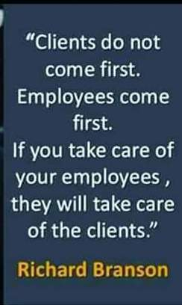
Page 06

Slide 8
Ethics
A principle of right or good or a system of such principles or values
Ethical behavior is based on written and unwritten codes of principles and values held in society.
Ethics reflect beliefs about what is right, what is wrong, what is just, what is unjust, what is good, and what is bad in terms of human behavior.
Ethical principles and values serve as a guide to behavior on a personal level, within professions, and at the organizational level.
To be ethical, one has to conform to the standards of conduct of a given profession or group.
Page 07

Slide 9
The Ethics Pyramid
Your Behavior
Rulings
Interpretations
Rules
Principles
Page 08

Slide 10
CODE OF PROFESSIONAL CONDUCT
Responsibilities
The Public Interest
Integrity
Objectivity & Independence
Due Care
Scope & Nature of Services
Page 09

Slide 11
Responsibilities
In carrying out our responsibilities as professionals, we, members of the Tax community, should exercise sensitive professional & moral judgments.
Page 10

Slide 12
The Public Interest
We should accept the obligation to act in a way that will serve the public interest, honor the public trust, & demonstrate commitment to Professionalism
Page 11

Slide 13
Integrity
To maintain and broaden public confidence, Tax Practitioners should perform all professional responsibilities with the highest sense of integrity.
Page 12

Slide 14
Objectivity and Independence
A Tax Practitioners should maintain objectivity and be free of conflicts of interest in discharging professional Responsibilities
Page 13

Slide 15
Due Care
A Tax Practitioners should observe the technical and ethical standards, strive continually to Improve competence & the quality of services, and discharge professional responsibility to the best of one’s ability.
Page 14

Slide 16
Scope and Nature of Services
The Tax Practitioners, are members in public practice just as accountants and should observe the principles of the Code of Professional Conduct in determining the scope and nature of services to be provided.
Page15

